Slide 1

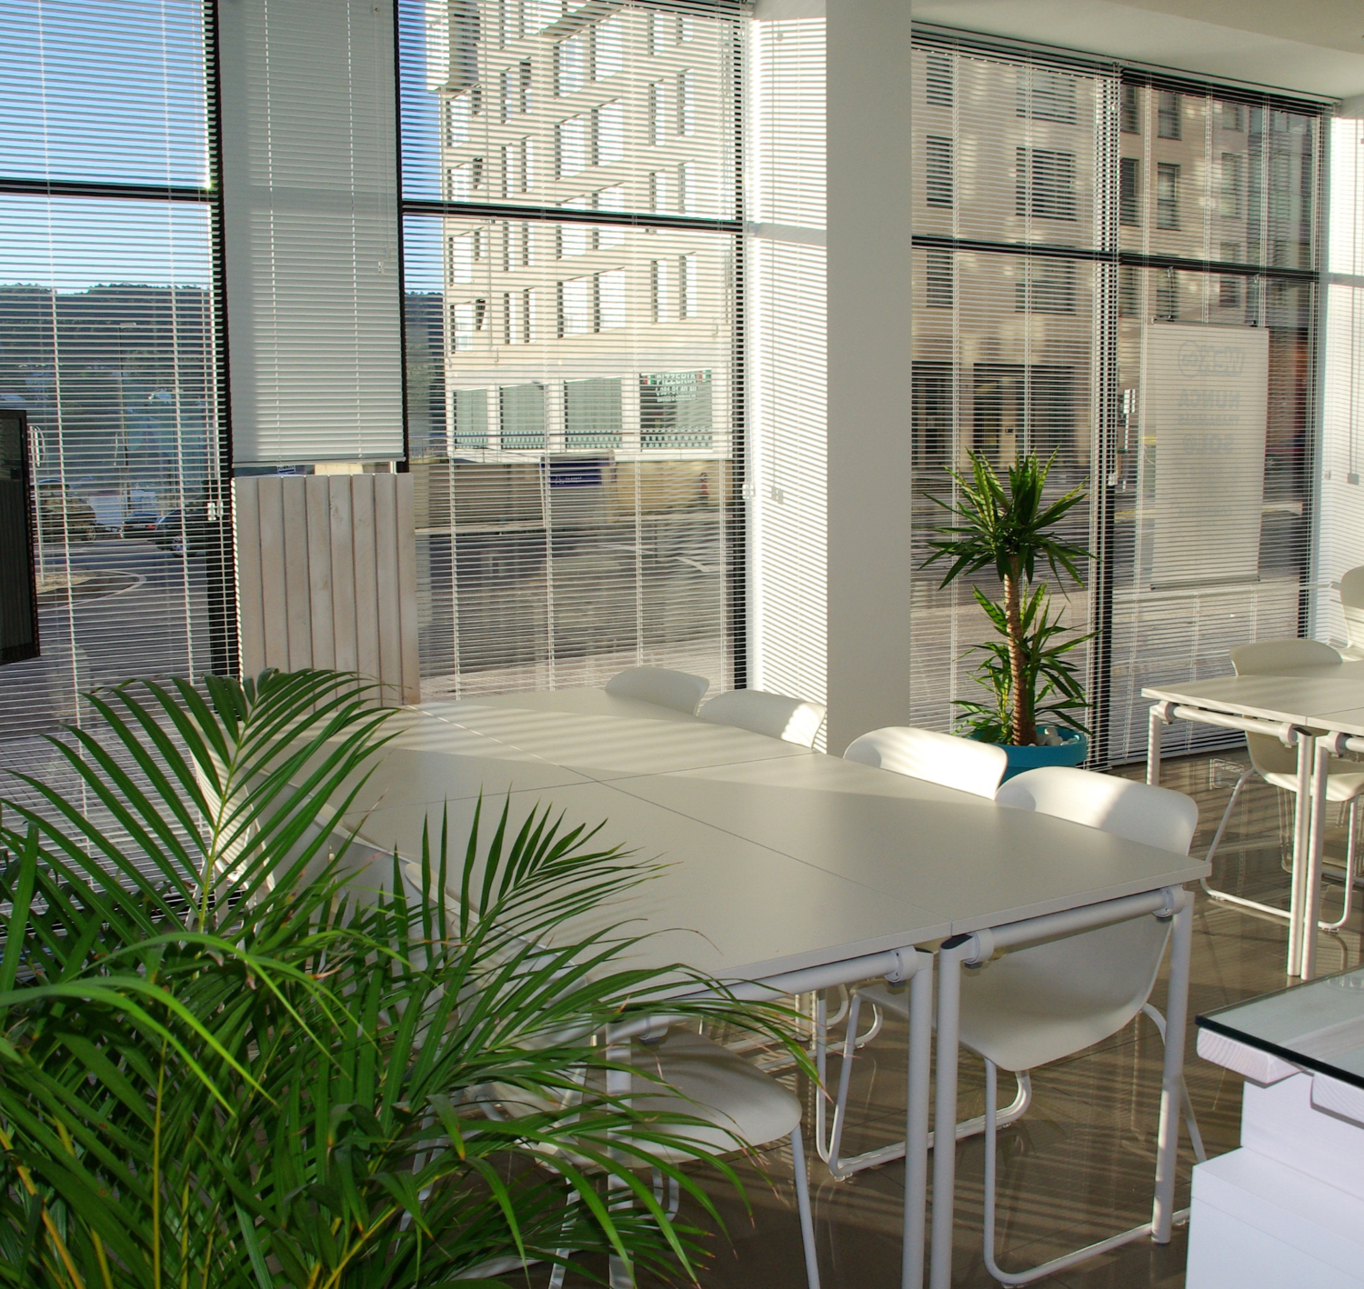

Automation in HR Onboarding & Communication Workflows Streamlining HR Operations with Automation
LTC
July 2025

Slide 2
June 2024
Agenda Page
Problem Statement
01.
02.
Solution Needs
Your Company
03.
High Level Data Flow
04.
Architectural View
05.
Benefits

Slide 3


Problem Statement
Issue:
Manual and repetitive tasks in HR onboarding and communication workflows.
Key Problems:
Tasks include extracting new joiner data, generating GIDs, sending appointment letters, onboarding emails, and managing document submissions.
Error-prone GID generation and email workflows.
Lack of scalability in onboarding.
June 2024
Your Company
Solution Needs:
Extract and validate employee data from Excel and documents.
Auto-generate GIDs and appointment letters using predefined formats.
Automate personalized email communications at onboarding stages.
Monitor inboxes, track document submissions, and update vetting statuses.
Solution Needs

Slide 4
June 2024
Objective: Automate HR onboarding, communication, and compliance workflows by integrating Workday, OCR and email automation UI tools to eliminate manual tasks, reduce errors, and improve efficiency. Solution Architecture Overview
The proposed solution leverages hyper-automation by integrating multiple solutions to streamline HR operations.
Key Components:
Web Front-End: Upload Excel, enter credentials, trigger automation (Flask - Python)
Data Extraction: Reads Excel file, validates data columns (pandas)
GID Generator: Creates unique employee IDs (Python UUID lib)
Document Generator: Creates personalized appointment letters (python-docx)
Email Sender: Sends onboarding emails with attachments (yagmail)
Storage: Stores uploaded Excel and generated documents (File system)
High-Level Solution Design
Your Company

Slide 5

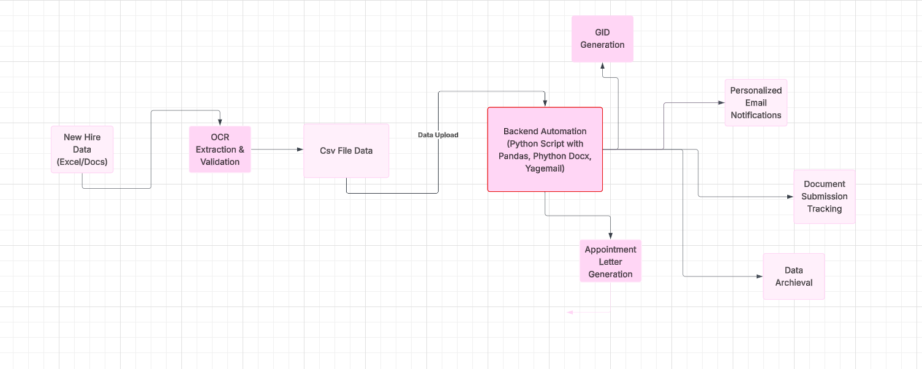
High Level Architectural Diagram
June 2024
Your Company

Slide 6
June 2024
Expected Benefits:
Focusing on reduction in manual tasks
Maintaining security & compliance is major goal.
Zero errors in GID generation & document handling.
Faster onboarding (from days to hours).
Full adhere to GDPR Policy.
Benefits
Your Company

Slide 7

June 2024
Your Company
Thank you!

Slide 8

































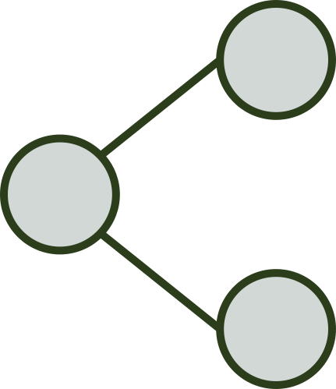





Resource Page
Use these design resources in your Canva Presentation.
Fonts
Design Elements
This presentation template
uses the following free fonts:
TITLES:
JOSEFIN SANS
HEADERS:
JOSEFIN SANS
BODY COPY:
POPPINS
You can find these fonts online too.
Colors
#000000
#B4D9C5
DON'T FORGET TO DELETE THIS PAGE BEFORE PRESENTING.

